Slide 1
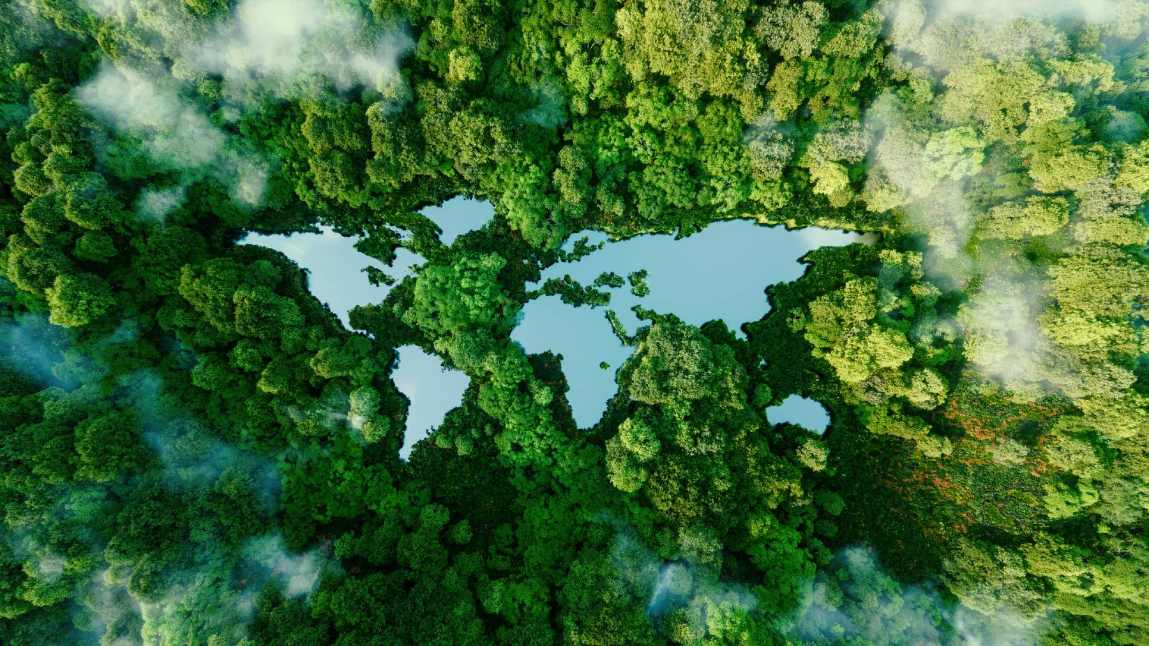




ammonia terminal, ammonia pipeline and hydrogen pipeline
ESIA PROCESS
8-10 July 2024

Slide 2
Agenda
Meeting objectives
Project Overview
About us
Environmental & Social Impact Assessment Process & Timeline
Baseline Studies

Slide 3
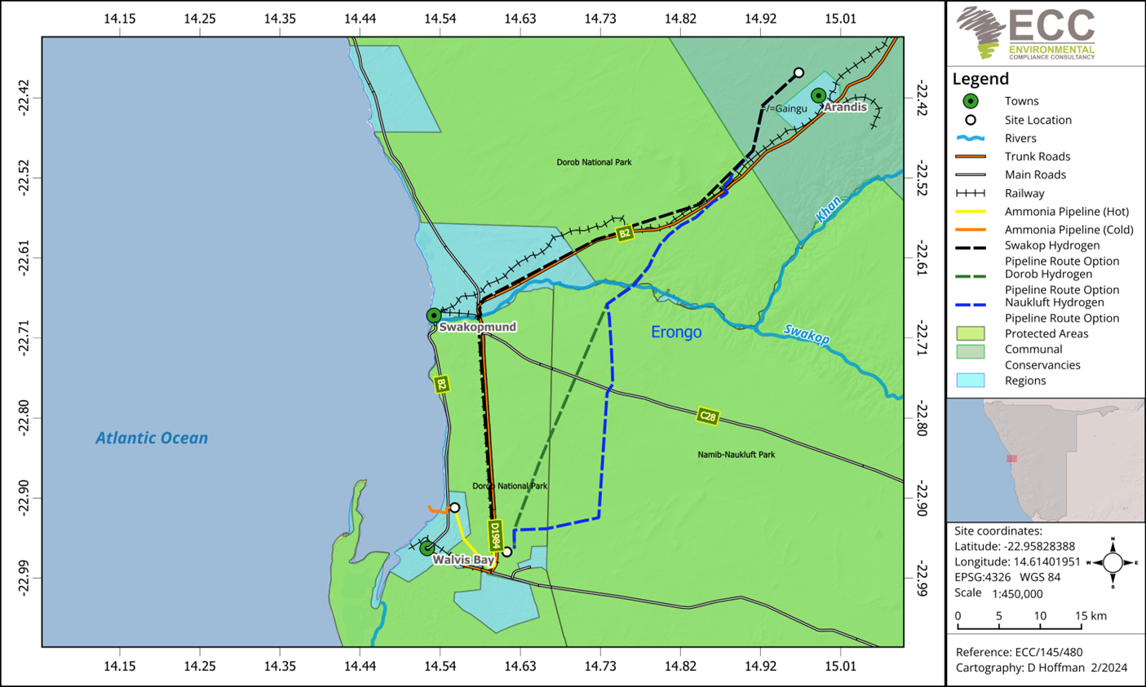

Slide 4
Project overview
Ammonia Terminal
ammonia pipeline
Hydrogen pipeline
The proposed project involves the construction of an ammonia terminal at the Walvis Bay port area, Erongo Region, Namibia.
The construction of a green ammonia pipeline whereby liquid ammonia with a mass flow between 20 to 60 ton/h will be transported 12.7 km from the ammonia production plant on Farm 58 to the ammonia terminal near the Walvis Bay port area for storage.
The construction of a green hydrogen pipeline. The pipeline will transport 15 000 m3 hydrogen gas (with a mass flow of 10 ton/h) from the production plant to the ammonia production plant on Farm 58.

Slide 5
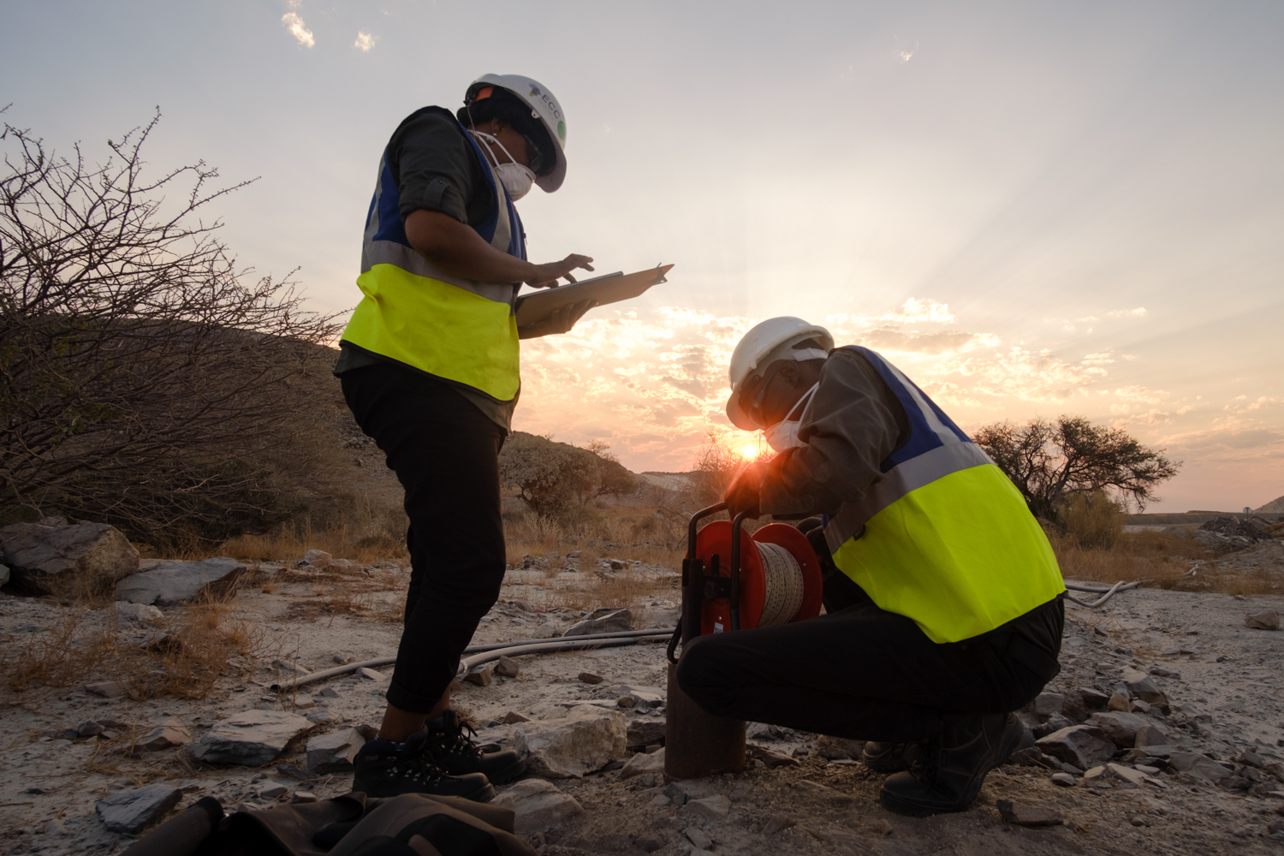
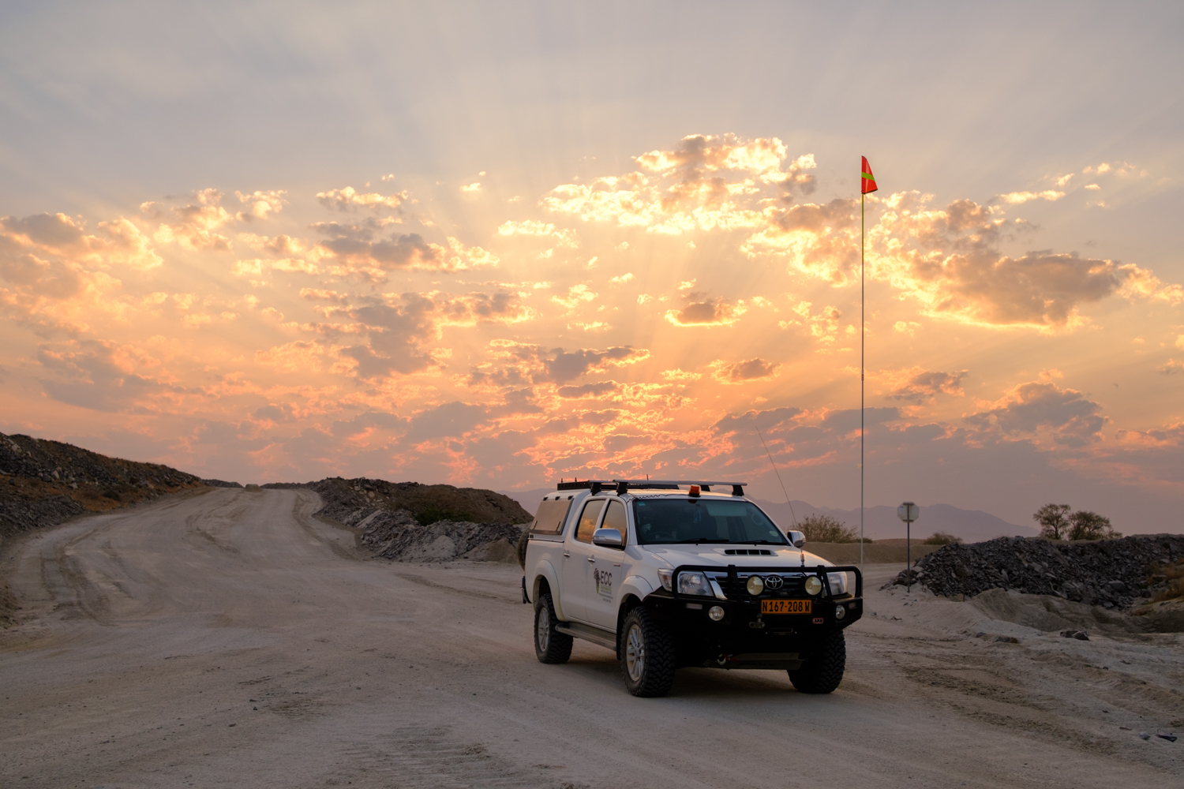
About us
We are Environmental Compliance Consultancy (Pty) Ltd (ECC) – the Environmental Assessment Practitioner.
ECC is an independent and unbiased Namibian environmental consulting firm.
Evidence and risk-based approach.

Slide 6
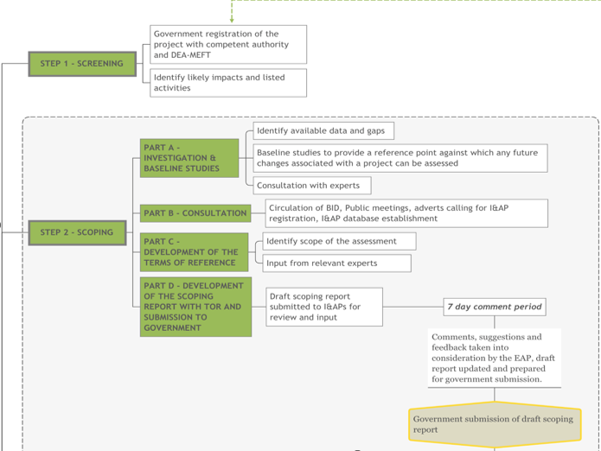
ESIA Process
ESIA steps ​
1. Screening
DEA Portal (Completed):
Ammonia terminal: APP-002566
Ammonia pipeline: APP-002567
Hydrogen pipeline: APP-002568
2. sCOPING
Current phase:
Define the scope of the project during the current phase.
The ammonia terminal final scoping report has been submitted to MME & MEFT.
The ammonia and hydrogen pipeline draft scoping report have been submitted to I&APs for review.

Slide 7
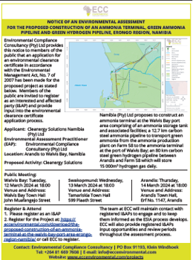
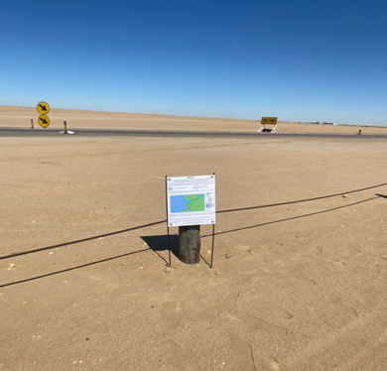
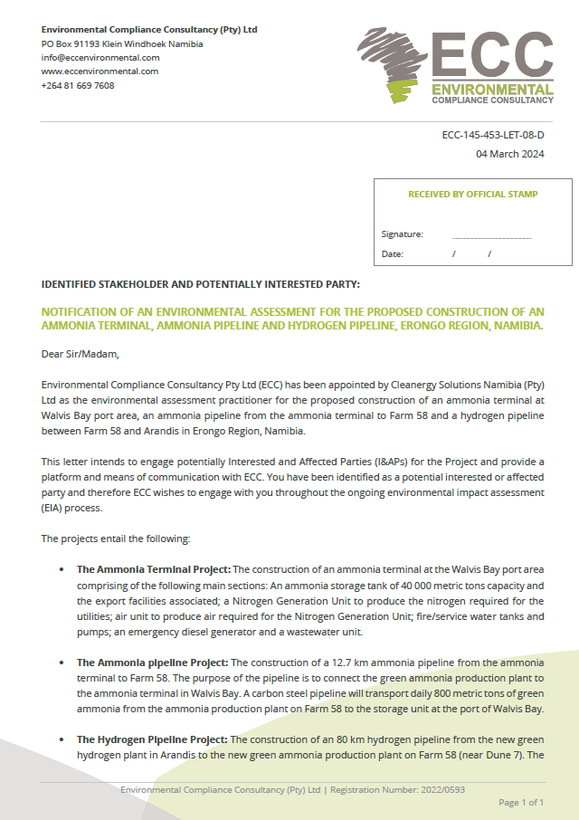
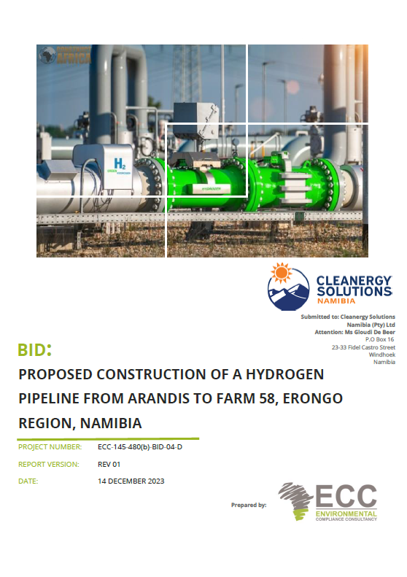
Public Participation
Notification of project included: Newspaper adverts, site notices, stakeholder letters, public notices
Background Information Document
Public meetings: Walvis Bay 12 March 2024; Swakopmund 13 March 2024; and Arandis 14 March 2024
Direct consultation and focus group meetings with stakeholders

Slide 8
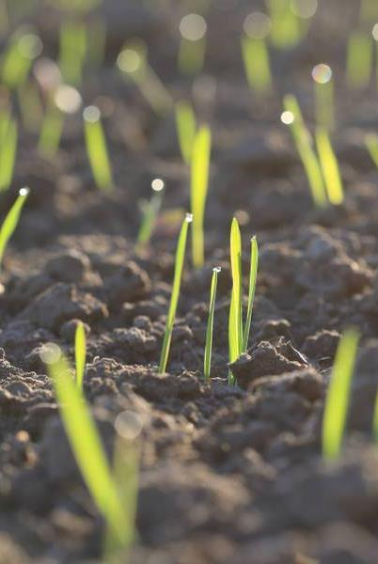
baseline Studies
Baseline studies | Specialist | Commissioned
Biodiversity and dune morphology | Peter Cunningham | ✓​ ​
Noise | AirShed | ✓​
Air quality | AirShed​ | ✓​ ​
Heritage​ | Rcheritage services | ✓​​ ​
Traffic | Zutari​ | ✓​​ ​
Climate change | ​RDJ Consulting Services | ​✓​​ ​
​Health and safety | Zutari​ | ​✓​​​
Groundwater and surface water​ | Umvoto | ​
Visual | ECC | ​✓​​​ ​
Socio-economic | ECC | ​✓​​​
Blast and vibration for Hydrogen pipeline​ | Blast Management & Consulting | ​✓​​​

Slide 9
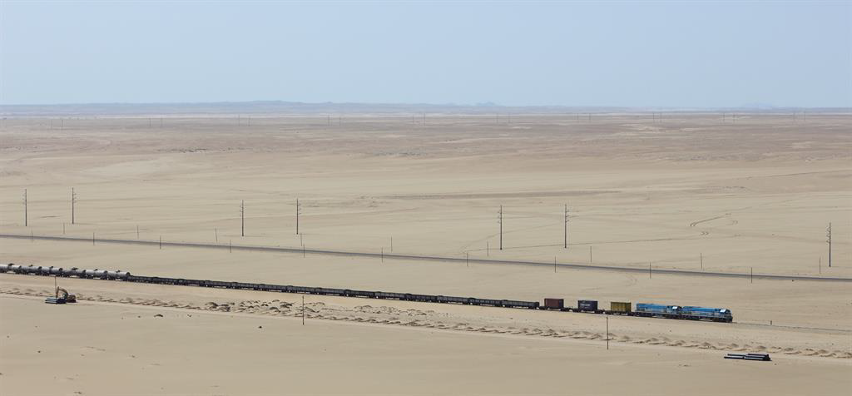
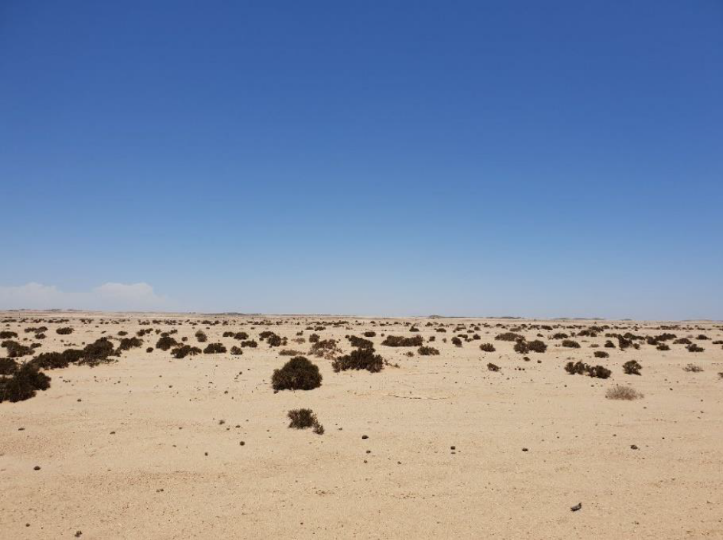
3. Assessment
Potential impacts to be assessed (Next phase)
Potential impacts that can arise from the proposed project include:
Noise impacts
Visual impacts
Landscape impacts
Dune morphology impacts
Linear infrastructure
Groundwater and surface water impacts
Impact on archaeological and cultural features
Biodiversity impacts
Increased traffic volumes off-site
Job creation (permanent / temporary)
Economic growth & emission reduction
Safety considerations for existing infrastructure and residents
Innovation & technology transfer

Slide 10

Please register as an interested and affected party
https://eccenvironmental.com/projects/
+264 81 669 7608
info@eccenvironmental.com
Google ECC to find our website and check under projects
Please use our ECC phone number to call or Whatsapp us
Feel free to reach out via our info email account.

Slide 11
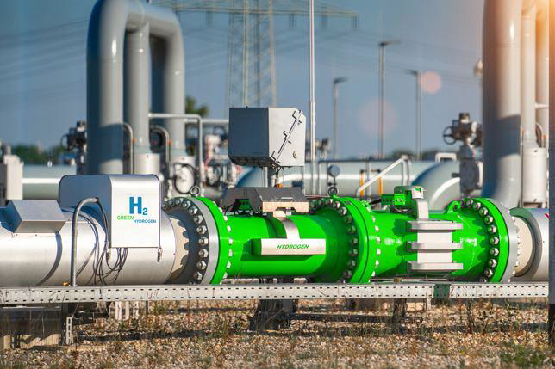
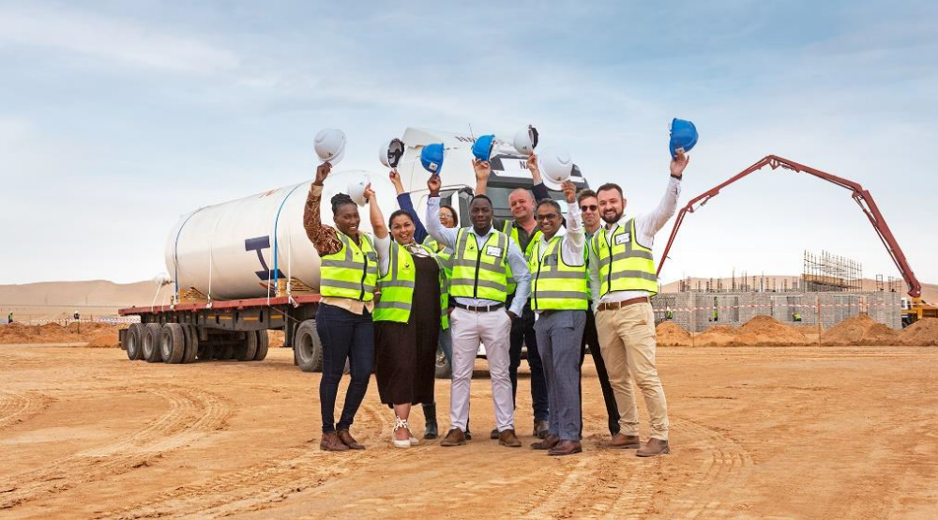
Thank you FOR YOUR TIME!
Contact Us:
Tel:+264 81 669 7608
info@eccenvironmental.com

