Slide 1

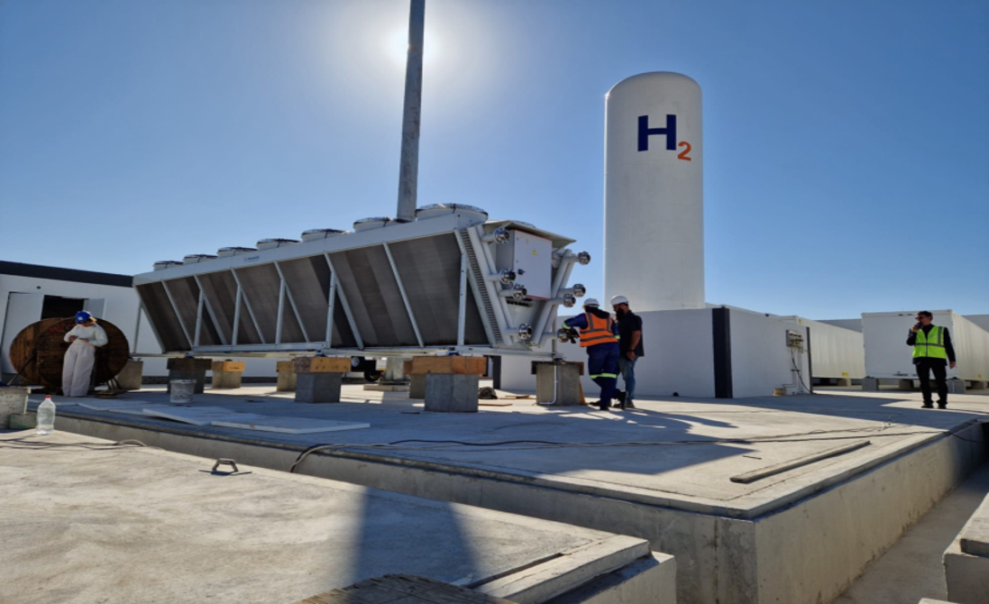
PV2Fuel Arandis – A green ammonia plant
ESIA PROCESS
21 July 2026

Slide 2
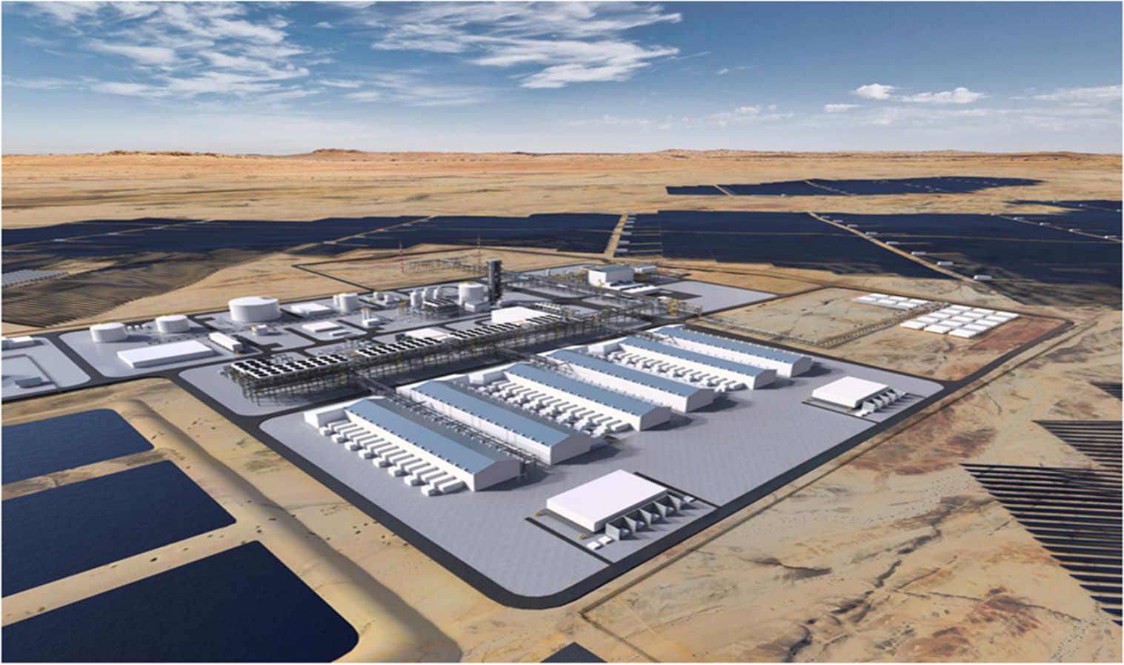
Welcome
Notes:
ECC is a proudly Namibian owned and operated company. We are an energetic and experienced team specialising in environmental services to the mining, agriculture, oil and gas and renewable energy sector in Namibia & Southern Africa.
ECC is also a member of the Namibian Chamber of Environment (NCE).
Forrest Stewardship Council (FSC®) membership registration number 3182
Stephan Bezuidenhout – EAP & (EAPAN), membership registration number 172 with 8 years of experience in environmental sector and specifically to today FSC and Ecology.

Slide 3
Agenda
Public meeting objectives
Project overview
Environmental and social impact assessment process & timeline
Baseline studies
Potential biophysical & socio-economic impacts
Review process

Slide 4

Public meeting objectives
Inform the public and provide information detailing the proposed Project.
Provide an overview of the environmental and social impact assessment process.
Take into consideration public concerns, questions and/or comments and incorporate this into the assessment process.

Slide 5
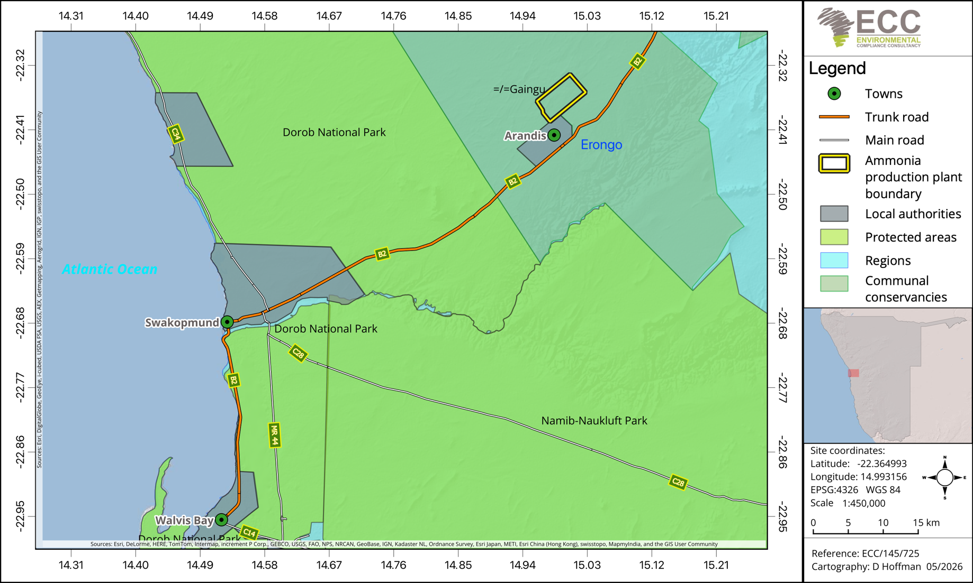
Locality map

Slide 6
Project overview
The Project is located on a 2400 hectares (ha) portion of land outside of the Arandis townlands.
The Project involves the production of green ammonia using renewable energy.
Electricity generated from a 1.2 gigawatts (GW) solar park is used to produce hydrogen via water electrolysis.
The hydrogen is then combined with nitrogen extracted from air to produce ammonia.
A battery energy storage system (BESS) of 1.5 gigawatt hour (GWh) supports a continuous and flexible operation by supplying electricity during periods of low solar generation (at night).
The ammonia will be transported via the proposed ammonia pipeline from the production location in Arandis to the approved ammonia terminal at the Walvis Bay North Port area.

Slide 7
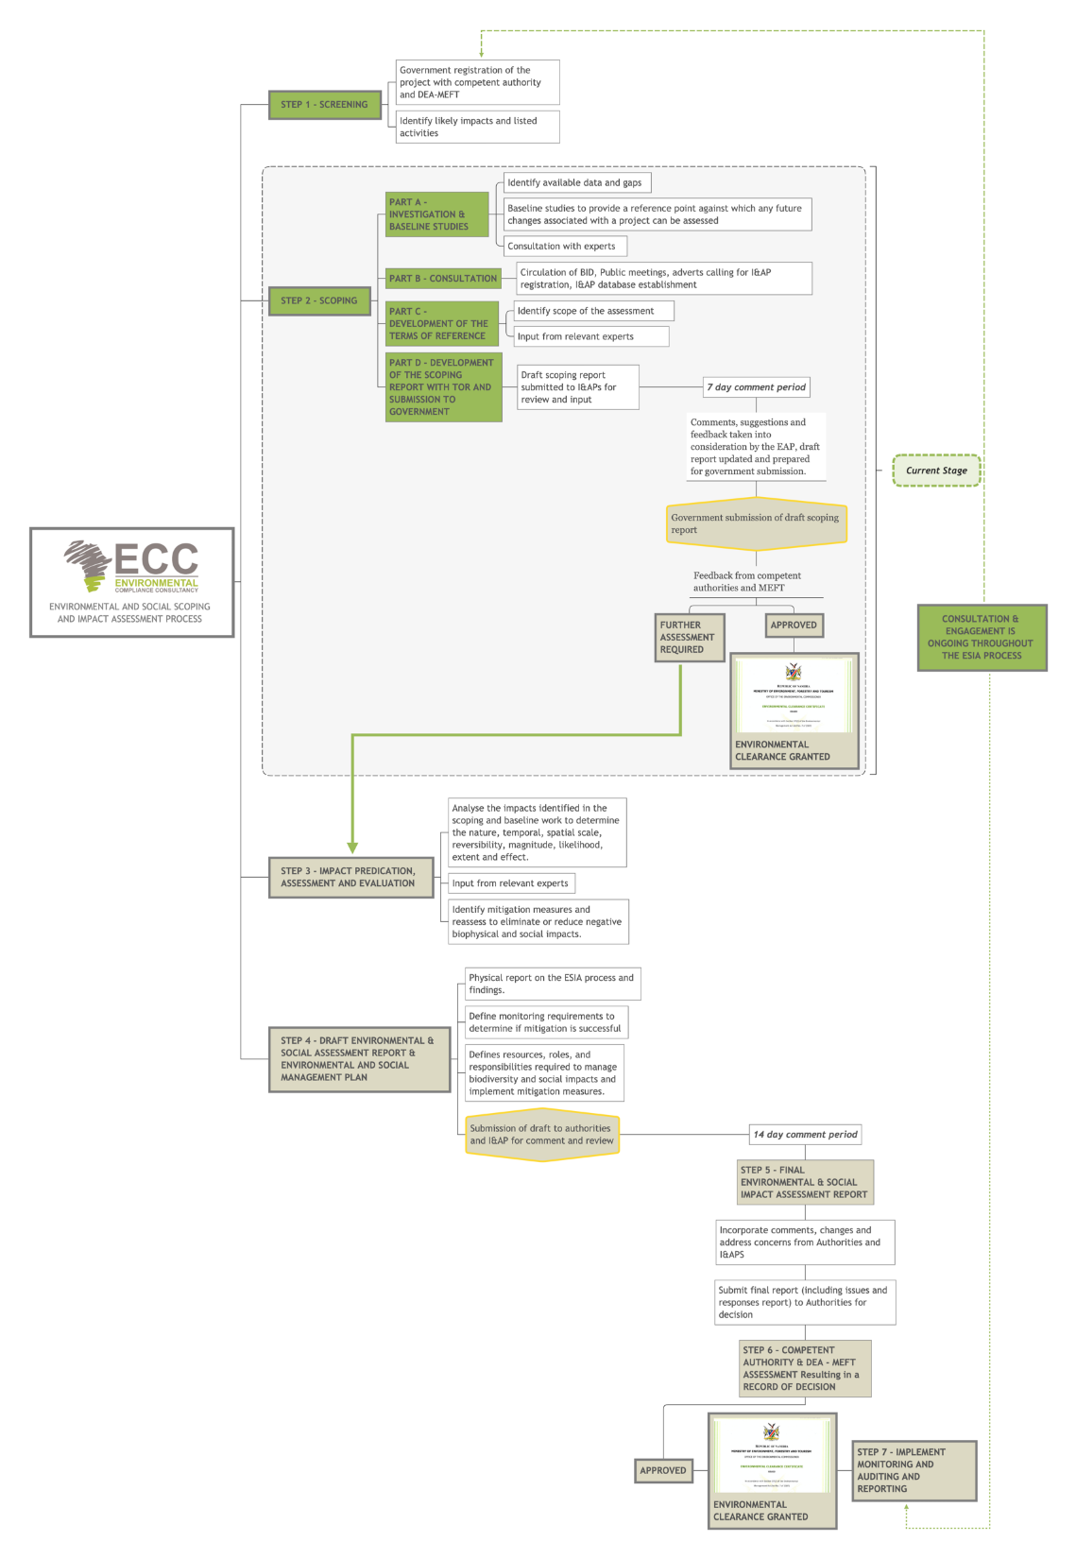
ESIA Process
Screening (DEAF portal): Completed
APP – 007541
Scoping – current phase
  Public participation
  Define the scope of the Project.

Slide 9
ESIA Process
Screening (DEAF portal)
Listed activities triggered as per the EMA No. 7 of 2007 and associated 2012 regulations:
ACTIVITIES THAT TRIGGERED A CLEARANCE CERTIFICATE APPLICATION | ESIA SCREENING FINDING
ENERGY GENERATION, TRANSMISSION AND STORAGE ACTIVITIES | Electricity will be produced through a 1.2 GW solar park. A battery energy storage system (BESS) of 1.5 GWh will be installed with the option to upscale to 3 gigawatt per hour (GWh). An emergency diesel generator is included in the Project design. An Electricity Generation Licence shall be obtained from the Electricity Control Board (ECB).
WASTE MANAGEMENT, TREATMENT, HANDLING AND DISPOSAL ACTIVITIES | General and non-hazardous waste from the Project construction and operations shall be transported by a license waste contractor to an approved disposal facility (Arandis Municipal Waste Disposal Site). Hazardous waste shall be collected by a licensed waste contractor (e.g., Rent-A-Drum Namibia) and transported to the nearest permitted industrial hazardous waste storage and handling facility, i.e., Walvis Bay.

Slide 10
ACTIVITIES THAT TRIGGERED A CLEARANCE CERTIFICATE APPLICATION | ESIA SCREENING FINDING
FORESTRY ACTIVITIES | Minimal vegetation clearing will be required where necessary; however, the area is largely sparsely vegetated.
WATER RESOURCE DEVELOPMENTS | The proposed use of evaporation ponds for the disposal of treated and potentially contaminated wastewater constitutes a discharge to the environment. In terms of the Water Resources Management Act, 2013 (Act No. 11 of 2013), a wastewater treatment, reuse and discharge licence shall be obtained from Ministry of Agriculture, Fisheries, Water, and Land Reform: Department of Water Affairs (MAFWLR:DWA). Water will be supplied from Arandis Municipality / NamWater
HAZARDOUS SUBSTANCE TREATMENT, HANDLING, AND STORAGE | Production and storage of hydrogen Production, storage and transport of ammonia. A hazardous substances licence/authorisation may be required from the Ministry of Health and Social Services (MoHSS) for the production, storage, handling, transport, and trade of hazardous substances. Nominal ammonia production capacity of the plant is 800 MTPD. During construction, portable sanitation facilities shall be provided on site and regularly serviced by an approved contractor and removed from site regularly.

Slide 11
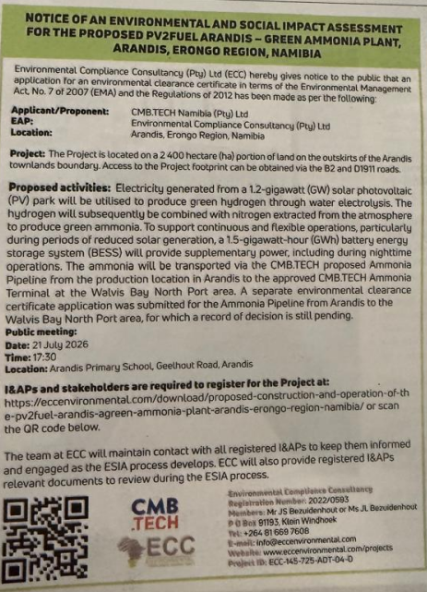
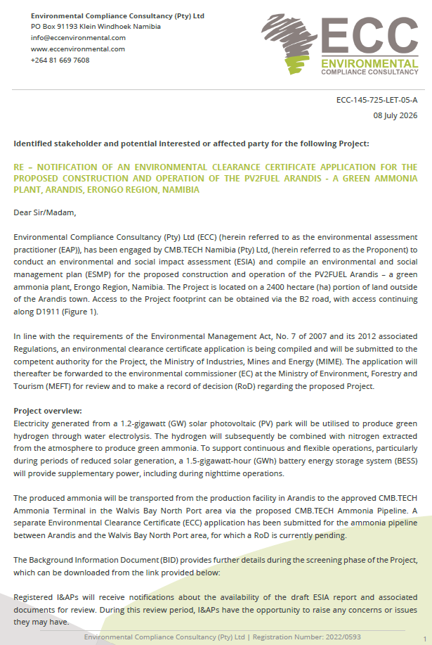
Public participation
Notification of Project included: Newspaper adverts, site notices, stakeholder letters.

Slide 12
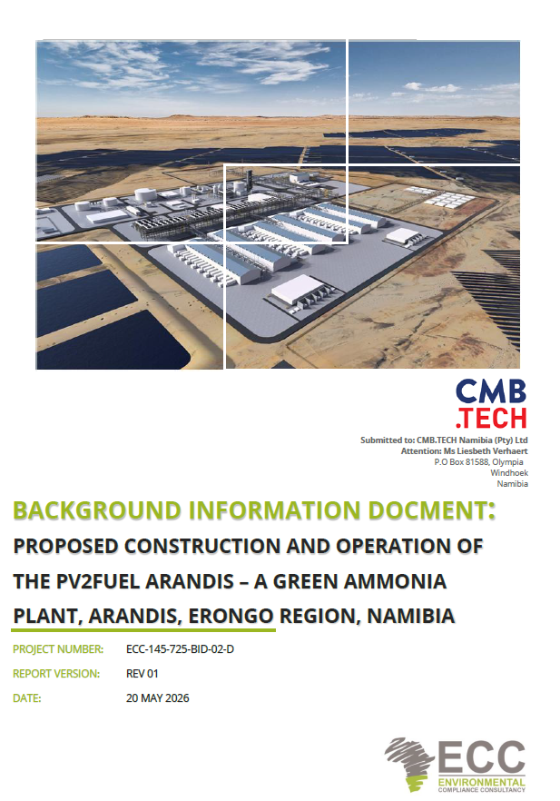
Public participation
The background information document (BID) is available on our website to provide an overview of the proposed Project.
https://eccenvironmental.com/download/proposed-construction-and-operation-of-the-pv2fuel-arandis-a-green-ammonia-plant-arandis-erongo-region-namibia/

Slide 13

Baseline Studies | Specialist
Biodiversity (vertebrate fauna and flora) | Peter Cunningham – Environment and Wildlife Consulting Namibia
Noise | Airshed Planning Professionals (Pty) Ltd
Air quality | Airshed​ Planning Professionals (Pty) Ltd
Heritage​ | ESM Cultural Heritage Consultants
Traffic | Innovative Transport Solutions Pty Ltd
​Health and safety | ​DNV Energy systems Risk Solutions
Groundwater and surface water​ | ECC
Visual | ECC
Socio-economic | ECC

Slide 14
Potential impacts to be assessed
Potential impacts that can be triggered by the proposed Project include, but are not limited to:
  Socio-economic environment:
    Noise impacts
    Visual impacts
    Impact on archaeological and cultural features
    Increased traffic volumes off-site
    Job creation (permanent / temporary)
    Skill development
    Economic growth & emission reduction
    Occupational health and safety
    Safety considerations for existing infrastructure & nearby residents
  Biophysical environment:
    Landscape impacts
    Groundwater and surface water impacts;
    Waste management;
    Biodiversity impacts; and
    Soil impacts.

Slide 15
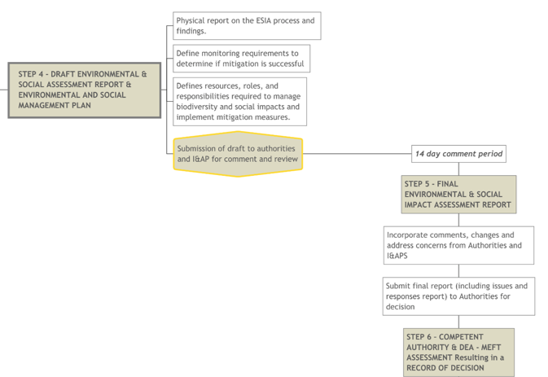
Review process

Slide 16

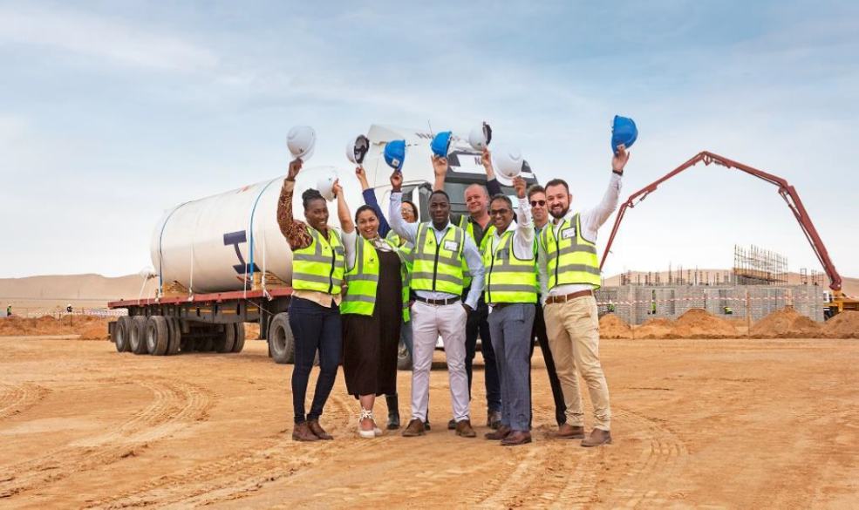
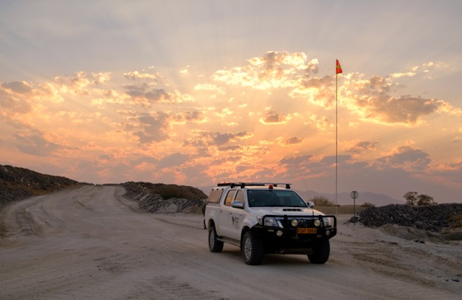
Contact us:
Tel: +264 81 669 7608
info@eccenvironmental.com

